Slide 1
Signal Analyzer App Kamran Jalil (19pwcse1751) Usman Yaqoob (19pwcse1754) Wisal Mukhtiar (19pwcse1756)
DSP LAB FINAL TERM PROJECT PRESENTATION

Slide 2
What is Signal Analyzer App?
Signal Analyzer is an interactive toolbox to analyze a signal.
It can visualize, measure, and compare signal in time domain, frequency domain, as well as in time-frequency domain.

Slide 3
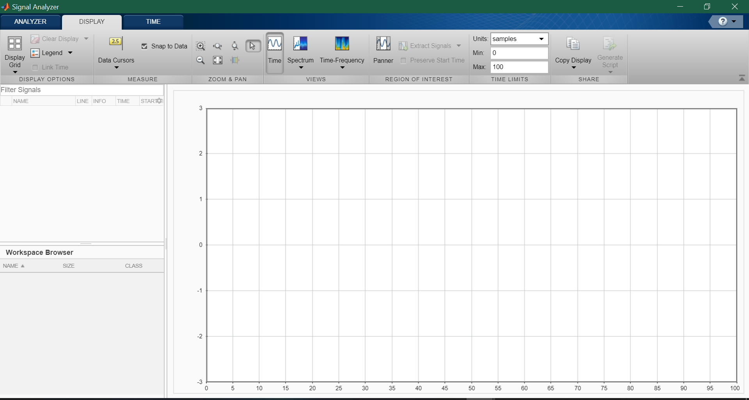
Signal Analyzer App Interface

Slide 4
MATLAB Code for importing audio signal clc; clear all; close all; [y,fs] = audioread("voicee.mp3");

Slide 5
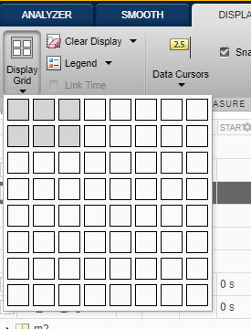
Viewing Multiple Plots on same window

Slide 6
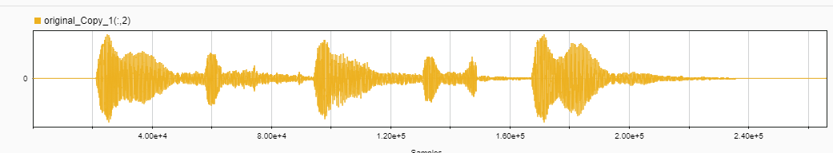
Original Signal in time domain

Slide 7

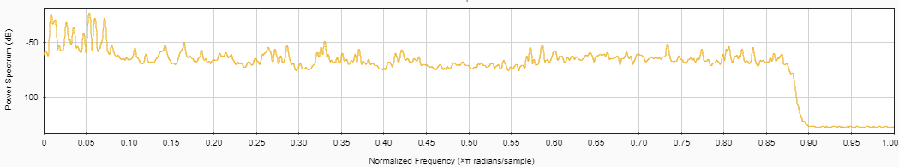
Original Signal in Frequency domain

Slide 8
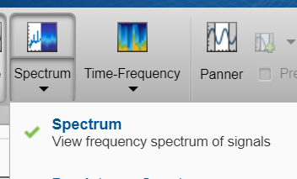
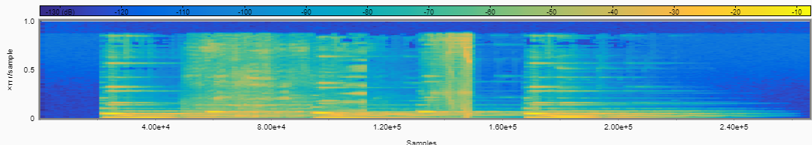
Original Signal’s spectrogram

Slide 9
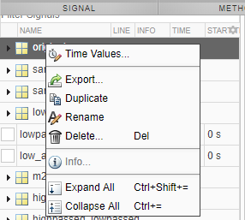
Duplicating the Original Signal:

Slide 10
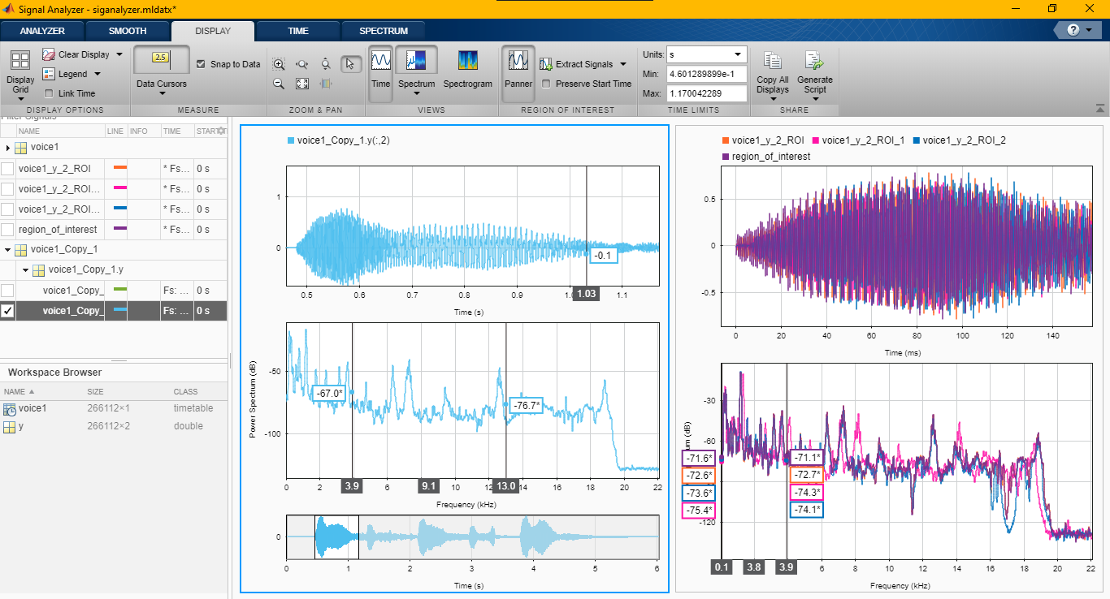
Extracting Different Regions of interest from signal

Slide 11
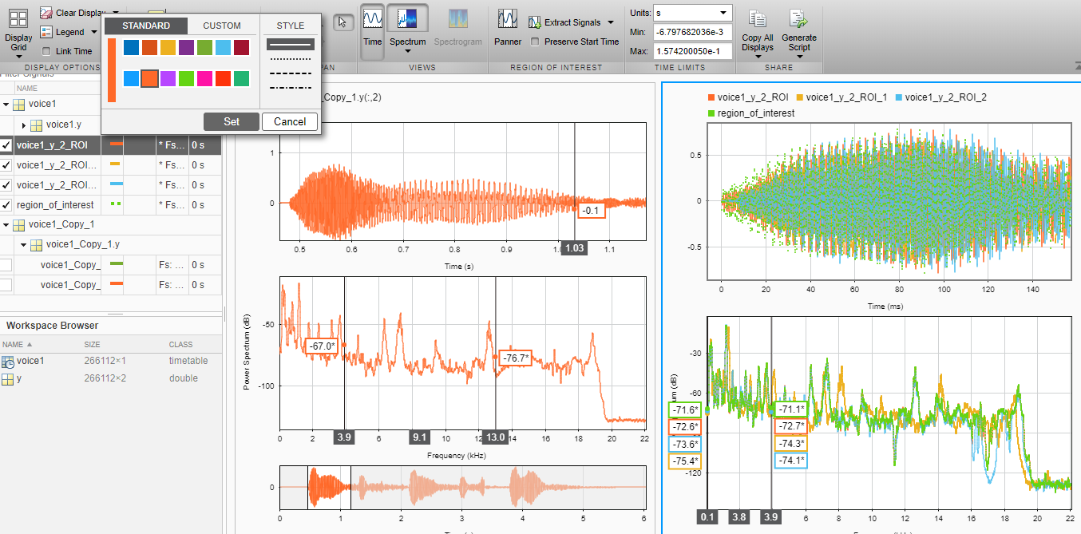
Extracting Different Regions of interest from signal

Slide 12
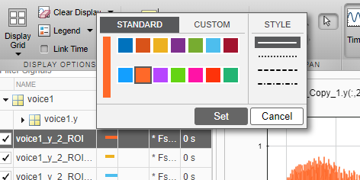
Labeling signals

Slide 13
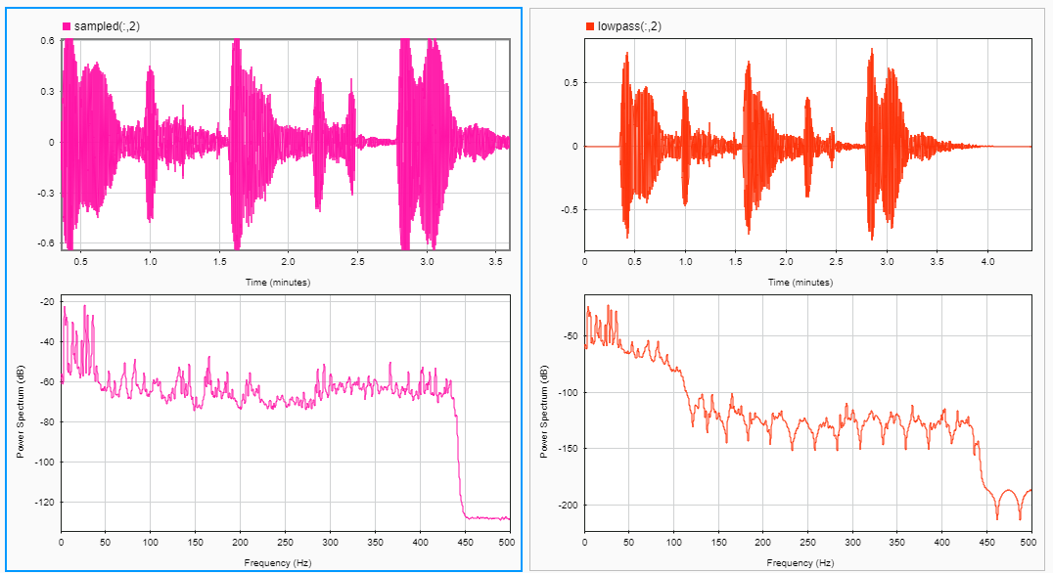
Applying Low pass filter(5Hz) on Duplicate signal:

Slide 14
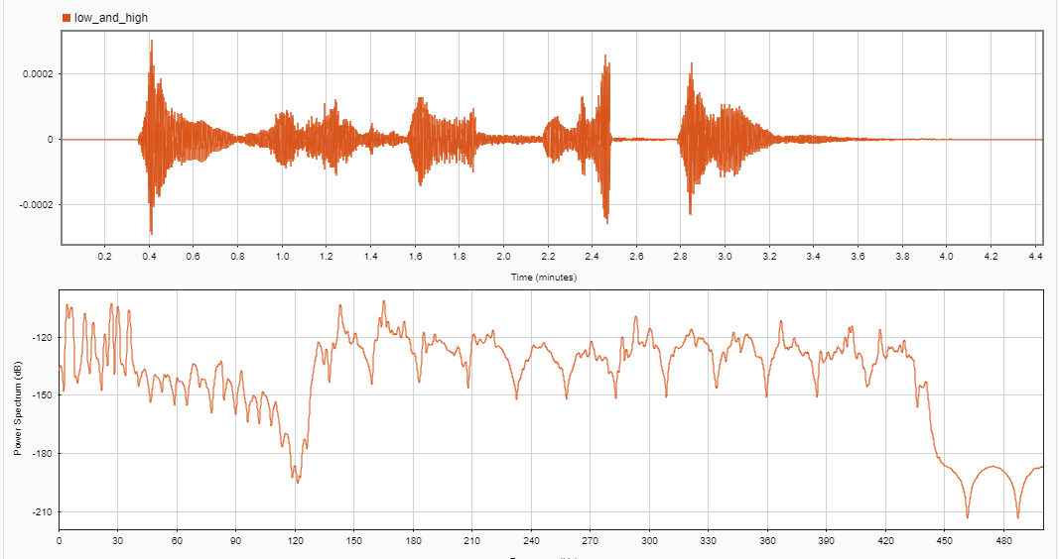
Applying High pass filter (50Hz) Filtered signal:

Slide 15
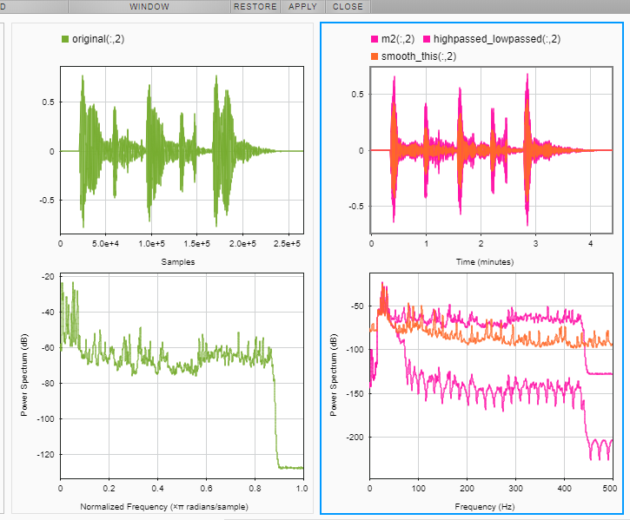
Smooth Moving Mean:

Slide 16
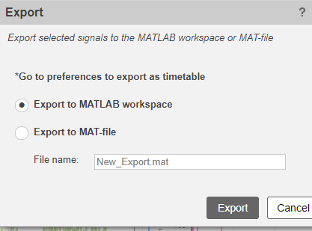
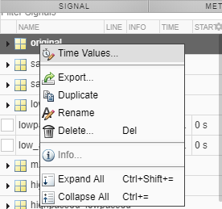
Exporting:

Slide 17
Selected a Signal to analyze. Preprocessed the signal (Filter). Explored the signals. Shared the analysis.
Conclusion

Slide 18
Thank You!

